Slide 1
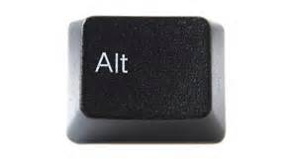
Welcome to Assessment Literacy Training
The ALTernative to Just Taking Tests

Slide 2
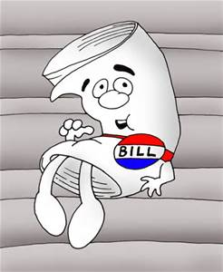
Let’s Review The UEA Alternative:
2012: SB 64 and Teacher Evaluation
The Standards
Educators Taking the Lead
The “Toolkit”
SAGE
Tested classes, grades
Assesses students, grades schools—not teachers
Student Learning Objectives (SLOs)
Non-tested classes and grades
But also for “core” classes, tested grades
Educator created, principal approved
Includes goals, targets and assessments
2015-16
70%/20%/10%
Affects your placement on your district’s salary schedule

Slide 3
ALT to
Better understand the role of valid assessment of student learning that isn’t just another test
Clarify how SLOs provide a way for educators to demonstrate what they do as professionals
set learning goals
establish targets
design valid assessments
Help members increase teaching effectiveness and improve student outcomes

Slide 4
Five Interactive Workshops
Data-Driven Instruction
Assessment Design
Differentiated Assessment
Self-Assessment: Rubrics, Goals and Reflection
Effective Student Feedback

Slide 5
ALT…
Provides flexibility and convenience for busy educators: At any location, take a single workshop or attend all five
Includes numerous interactive discussion questions and activities
Contains materials and resources to extend learning after the workshop
Affords educators opportunities to work together on assessment
Engages educators in conversations about best practices
Offers Weber State credit and licensure points

Slide 6
ALT:CTRL—DEL UEA…
Continues leading; Controls the conversation
Still taking the lead on evaluation and assessment
Always helping teachers meet challenges
Delivers relevant PD; Deletes anxiety
Providing forums for learning and collaboration
Providing value for membership while being a resource to all public education stakeholders

Slide 7
Assessment Literacy
Is a natural continuation of ETTL & evaluation
Is something that (alongside SLOs) teachers do
Will factor into salary schedules

Slide 8
Assessment Literacy Training
Provides--
Alternative
Leadership
to
Testing

Slide 9
AND PROVIDES AN Alternative to Lame Testing

